Slide 1
Text Document Representation & Indexing
----Vector Space Model
Jianping Fan
Dept of Computer Science
UNC-Charlotte

Slide 2
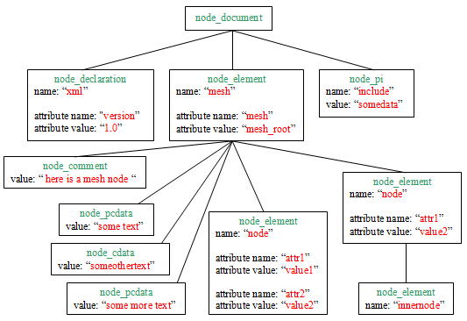
TEXT DOCUMENT ANALYSIS & TERM EXTRACTION
-------WEB PAGE CASE
Document Analysis: DOM-tree-based page segmentation
DOM: Document Object Model
DOM-Tree

Slide 3
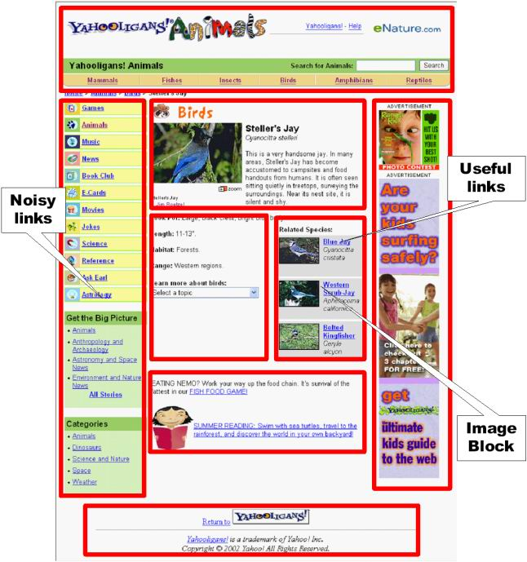
TEXT DOCUMENT ANALYSIS & TERM EXTRACTION
-------WEB PAGE CASE
Document Analysis: visual-based page segmentation
Visual-based page
Segmentation

Slide 4
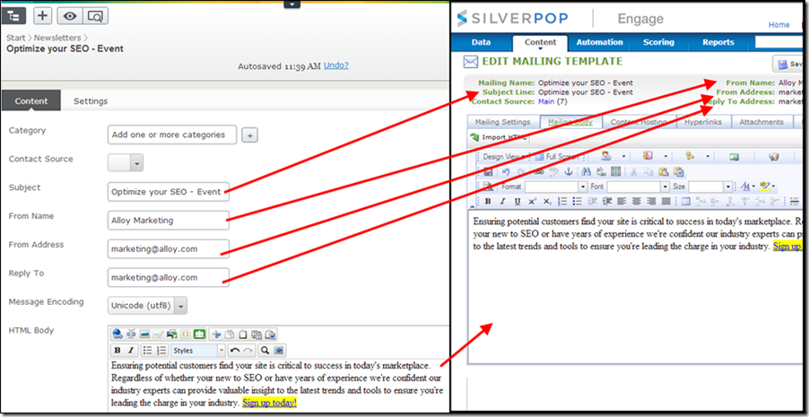
TEXT DOCUMENT ANALYSIS & TERM EXTRACTION
-------WEB PAGE CASE
Document Analysis: rule-based page segmentation
Visual-based
Segmentation

Slide 5
TEXT DOCUMENT ANALYSIS & TERM EXTRACTION
-------WEB PAGE CASE
Document Analysis Text Paragraphs
Term Extraction: natural language processing
Phrase Chunking
Noun Phrases, Named Entities, ……

Slide 6
NAMED ENTITY EXTRACTION
Named Entities
  Locations
  Human Names
  Interesting Terms
  ……

Slide 7
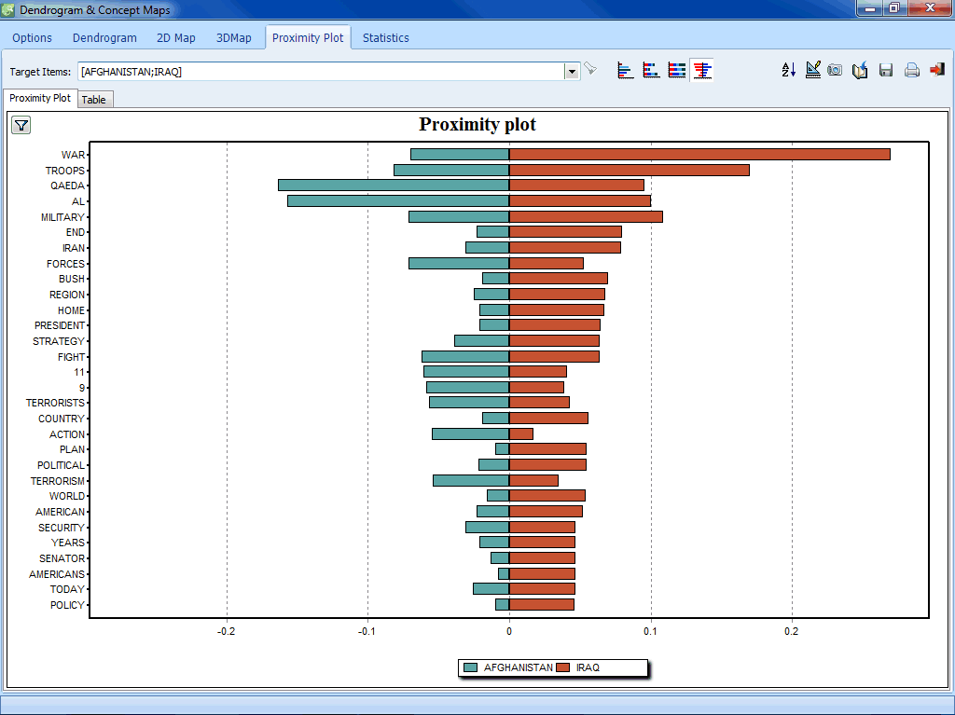
TEXT DOCUMENT ANALYSIS & TERM EXTRACTION
-------WEB PAGE CASE
Term Frequency Determination

Slide 8
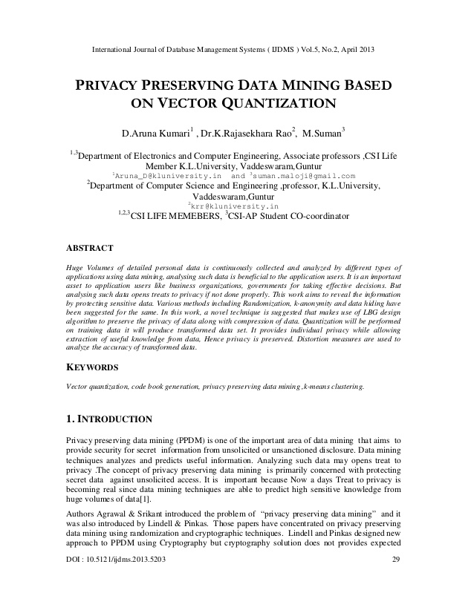
TEXT DOCUMENT REPRESENTATION
(terms, frequencies)
Words, Phrases
Named Entities
&
Frequencies

Slide 9
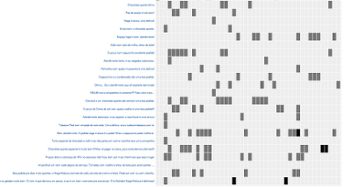
TEXT DOCUMENT REPRESENTATION
Sparse
For a given document, only a
small number of terms appear!
Frequency is not enough!

Slide 10
TEXT DOCUMENT REPRESENTATION
Document represented by a vector of terms
  Words (or word stems)
  Phrases (e.g. computer science)
  Removes words on “stop list”
    Documents aren’t about “the”
Often assumed that terms are uncorrelated.
Correlations between their term vectors for two documents implies their similarity.
For efficiency, an inverted index of terms is often stored.

Slide 11
TEXT DOCUMENT REPRESENTATION
WHAT VALUES TO USE FOR TERMS
Boolean (term present /absent)
tf (term frequency) - Count of times term occurs in document.
  The more times a term t occurs in document d the more likely it is that t is relevant to the document.
  Used alone, favors common words, long documents.
df( document frequency)
  The more a term t occurs throughout all documents, the more poorly t discriminates between documents
tf-idf (term frequency * inverse document frequency) -
  High value indicates that the word occurs more often in this document than average.

Slide 12
TEXT DOCUMENT REPRESENTATION
(terms, tf-idf)
Words, Phrases
Named Entities
&
tf-idf

Slide 13
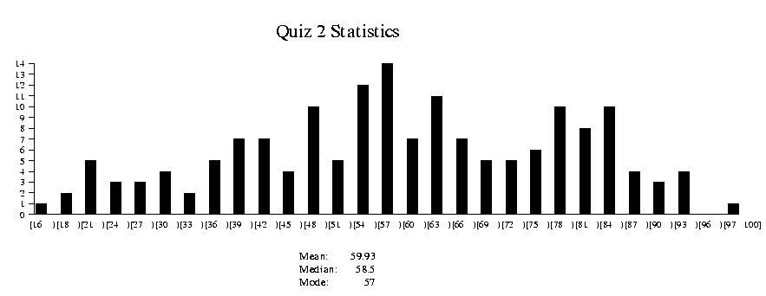
DOCUMENT VECTORS
Documents are represented as “bags of words”
Represented as vectors when used computationally
  A vector is like an array of floating point
  Has direction and magnitude
  Each vector holds a place for every term in the collection
  Therefore, most vectors are sparse
tf*idf

Slide 14
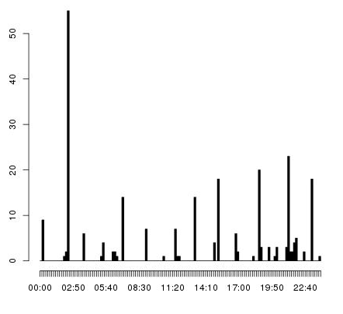
DOCUMENT VECTORS
Sparse Representation
tf*idf

Slide 15
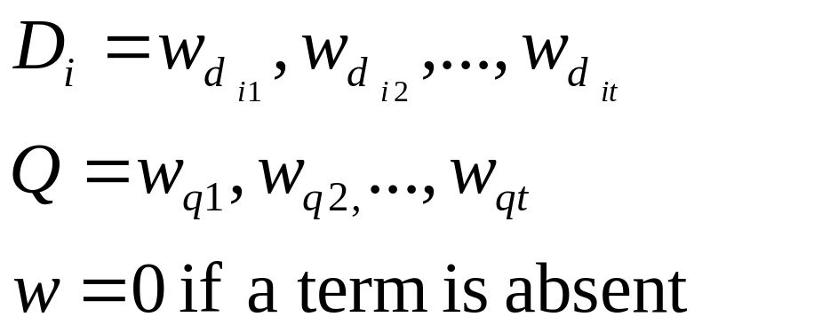
VECTOR REPRESENTATION
Documents and Queries are represented as vectors.
Position 1 corresponds to term 1, position 2 to term 2, position t to term t
tf-idf

Slide 16
ASSIGNING WEIGHTS
Want to weight terms highly if they are
  frequent in relevant documents … BUT
  infrequent in the collection as a whole
tf-idf
Bag-of-words
word

Slide 17
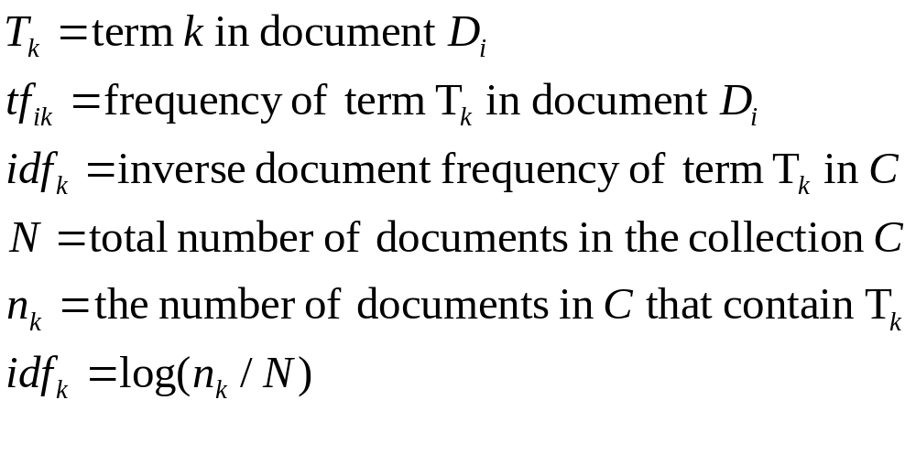
ASSIGNING WEIGHTS
tf*idf measure:
  term frequency (tf)
  inverse document frequency (idf)

Slide 18

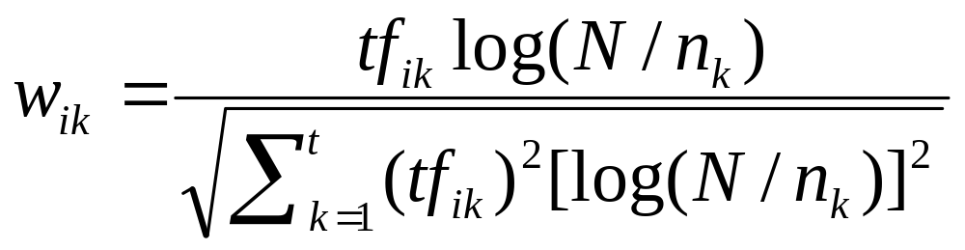
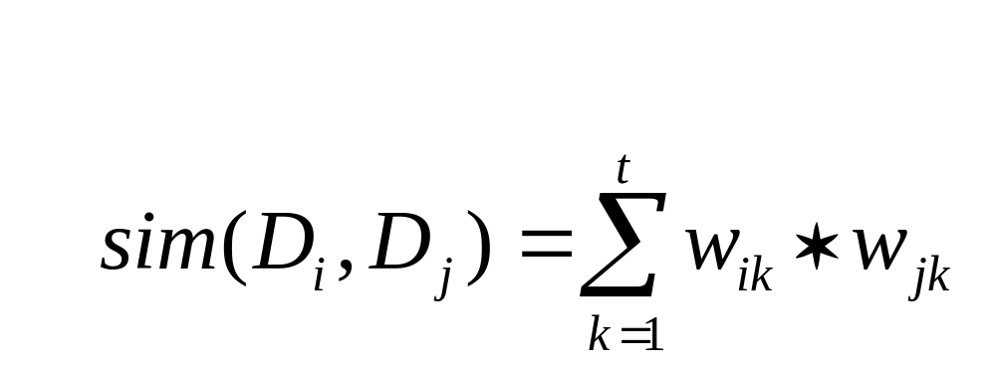
Normalize the term weights (so longer documents are not unfairly given more weight)
normalization
Document Similarity:

Slide 19

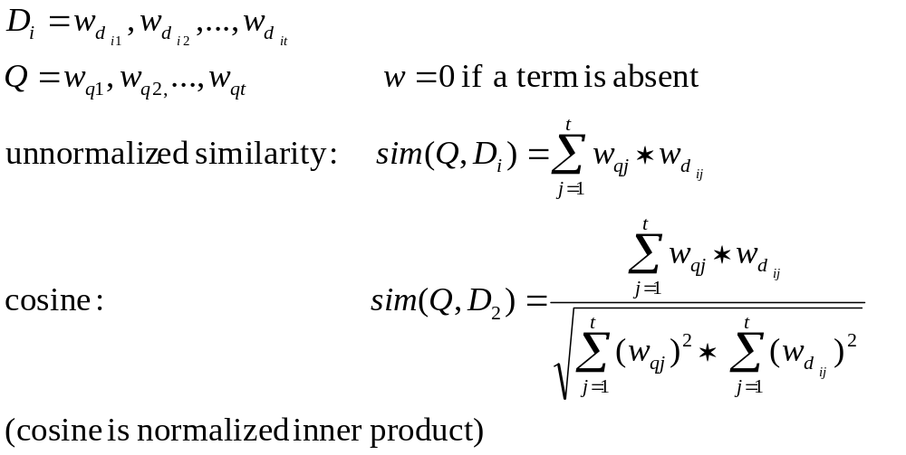
VECTOR SPACE SIMILARITY MEASURE
COMBINE INTO A SIMILARITY MEASURE

Slide 20
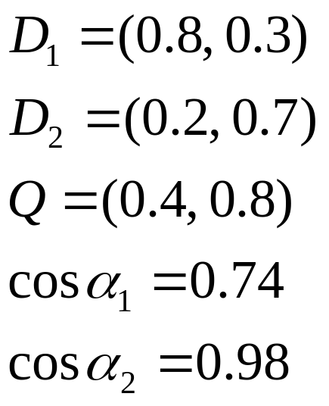





COMPUTING SIMILARITY SCORES
1.0
0.8
0.6
0.4
0.2
0.2
0.4
0.6
0.8
1.0

Slide 21
DOCUMENTS IN VECTOR SPACE
t₃
D₁
D₉
D₁₁
D₃
D₅
D₁₀
D₄
D₂
t₁
D₇
D₈
D₆
t₂

Slide 22
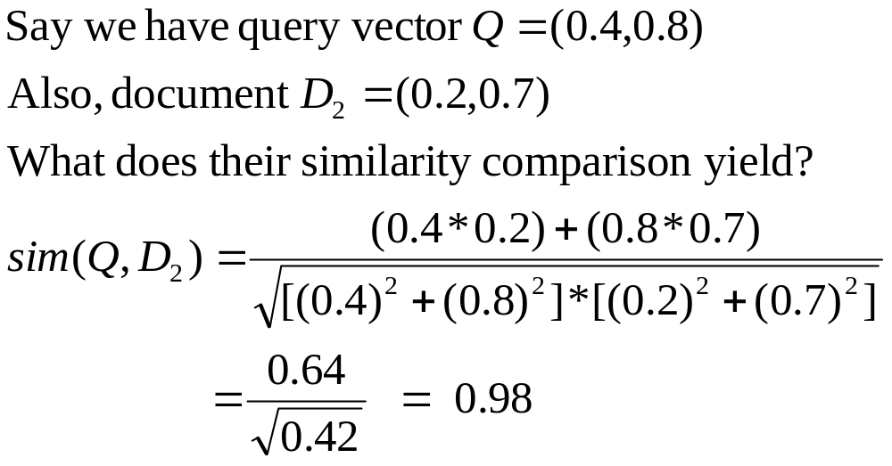
COMPUTING A SIMILARITY SCORE

Slide 23
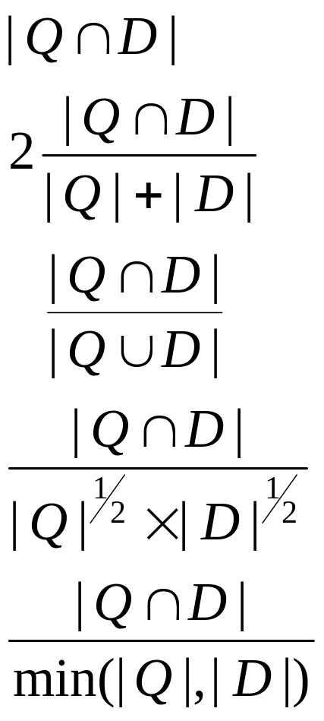
SIMILARITY MEASURES
Simple matching (coordination level match)
Dice’s Coefficient
Jaccard’s Coefficient
Cosine Coefficient
Overlap Coefficient

Slide 24
PROBLEMS WITH VECTOR SPACE
There is no real theoretical basis for the assumption of a term space
  it is more for visualization that having any real basis
  most similarity measures work about the same regardless of model
Terms are not really orthogonal dimensions
  Terms are not independent of all other terms

Slide 25
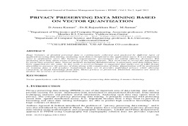
Large-Scale Web Page/Document Collections
(term ID, tf-idf)

Slide 26
WEB PAGES/DOCUMENTS DATABASES MATRIX
Terms or Term ID
tf-idf
Web Page or Document ID

Slide 27
DOCUMENTS DATABASES MATRIX
Document ids
nova galaxy heat h’wood film role diet fur
1.0 0.5 0.3
0.5 1.0
1.0 0.8 0.7
0.9 1.0 0.5
1.0 1.0
0.9 1.0
0.5 0.7 0.9
0.6 1.0 0.3 0.2 0.8
0.7 0.5 0.1 0.3
A
B
C
D
E
F
G
H
I

Slide 28
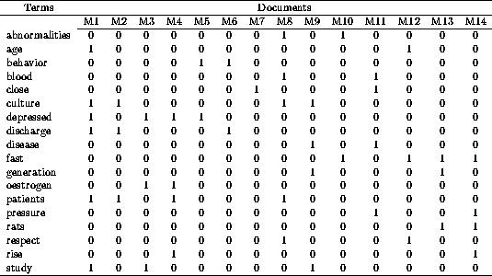
DOCUMENTS DATABASES MATRIX
Large numbers of Text Terms: 5000 common items
Large numbers of Documents: Billions of Web pages

Slide 29
INDEXING STRUCTURE
Terms or Term ID
(tf-idf, D/P-ID)
Web Page or Document ID

Slide 30
INDEXING STRUCTURE
Fast Search
Better Ranking (generating ranking list)
Pagelink-based ranking

Slide 31
INDEXING TECHNIQUES
Inverted files
  best choice for most applications
Signature files & bitmaps
    word-oriented index structures based on hashing
Arrays
    faster for phrase searches & less common queries
    harder to build & maintain
Design issues:
  Search cost & space overhead
  Cost of building & updating

Slide 32
INVERTED LIST: MOST COMMON INDEXING TECHNIQUE
Source file: collection, organized by document
Inverted file: collection organized by term
  one record per term, listing locations where term occurs
Searching: traverse lists for each query term
  OR: the union of component lists
  AND: an intersection of component lists
  Proximity: an intersection of component lists
  SUM: the union of component lists; each entry has a score

Slide 33
INVERTED FILES
Contains inverted lists
  one for each word in the vocabulary
  identifies locations of all occurrences of a word in the original text
    which ‘documents’ contain the word
    Perhaps locations of occurrence within documents
Requires a lexicon or vocabulary list
  provides mapping between word and its inverted list
Single term query could be answered by
  scan the term’s inverted list
  return every doc on the list

Slide 34
INVERTED FILES
Index granularity refers to the accuracy with which term locations are identified
  coarse grained may identify only a block of text
    each block may contain several documents
  moderate grained will store locations in terms of document numbers
  finely grained indices will return a sentence, word number, or byte number (location in original text)

Slide 35
THE INVERTED LISTS
Data stored in inverted list:
  The term, document frequency (df), list of DocIds
    government, 3, <5, 18, 26,>
  List of pairs of DocId and term frequency (tf)
    government, 3 <(5, 2), (18, 1)(26, 2)>
  List of DocId and positions
    government, 3 <5, 25, 56><18, 4><26, 12, 43>

Slide 36
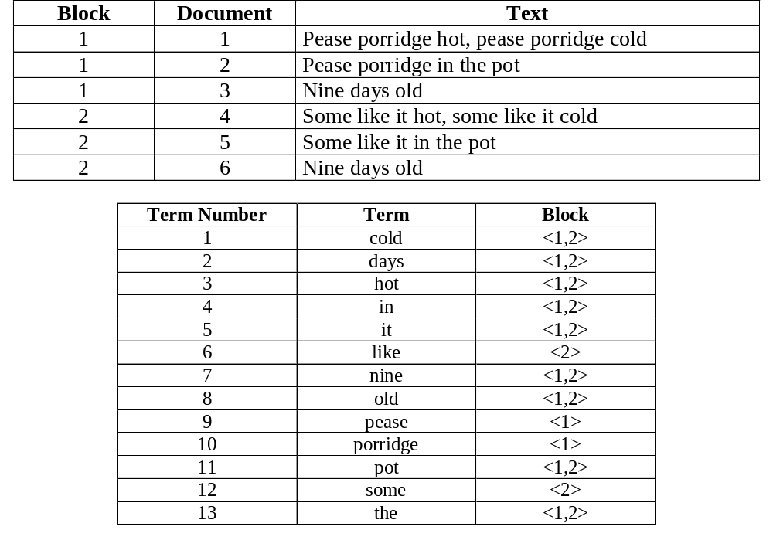
INVERTED FILES: COARSE

Slide 37
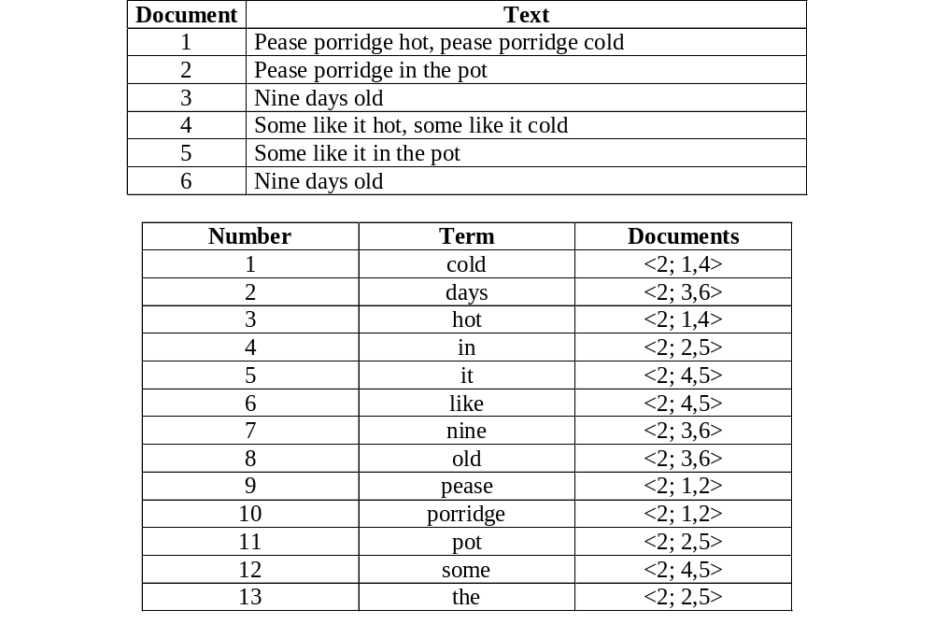
INVERTED FILES: MEDIUM

Slide 38
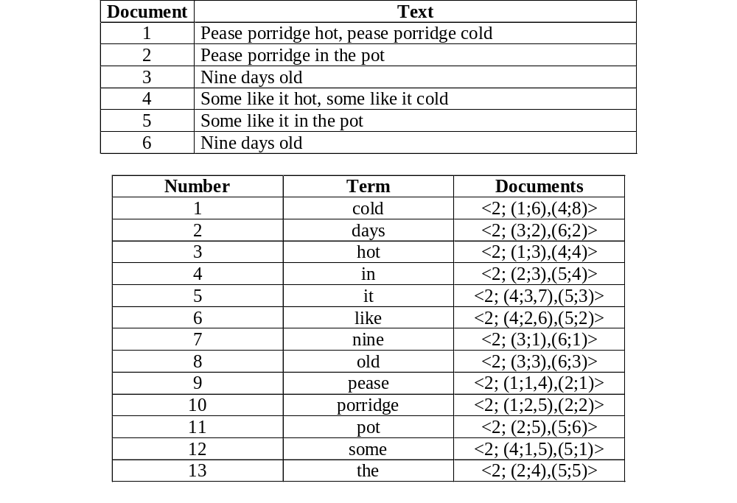
INVERTED FILES: FINE

Slide 39
INDEX GRANULARITY
Can you think of any differences between these in terms of storage needs or search effectiveness?
  coarse: identify a block of text (potentially many docs)
  fine : store sentence, word or byte number
less storage space, but more searching of plain text to
find exact locations of search terms
more false matches when multiple words. Why?
Enables queries to contain proximity information
  e.g.) “green house” versus green AND house
Proximity info increases index size 2-3x
  only include doc info if proximity will not be used
Notes:
Multiple words generate false matches since all words may occur in the same block, but not necessarily in the same doc(s)

Slide 40
INDEXES: BITMAPS
Bag-of-words index only: term x document array
For each term, allocate vector with 1 bit per document
If term present in document n, set n’th bit to 1, else 0
Boolean operations very fast
Extravagant of storage: N*n bits needed
  2 Gbytes text requires 40 Gbyte bitmap
  Space efficient for common terms as high prop. bits set
  Space inefficient for rare terms (why?)
Not widely used

Slide 41
INDEXES: SIGNATURE FILES
Bag-of-words only: probabilistic indexing
Allocate fixed size s-bit vector (signature) per term
Use multiple hash functions generating values in the range 1 .. s
  the values generated by each hash are the bits to set in the signature
OR the term signatures to form document signature
Match query to doc: check whether bits corresponding to term signature are set in doc signature

Slide 42
INDEXES: SIGNATURE FILES
When a bit is set in a q-term mask, but not in doc mask, word is not present in doc
s-bit signature may not be unique
  Corresponding bits can be set even though word is not present (false drop)
    Challenge: design file to ensure p(false drop) is low, while keeping signature file as short as possible
  document must be fetched and scanned to ensure a match

Slide 43
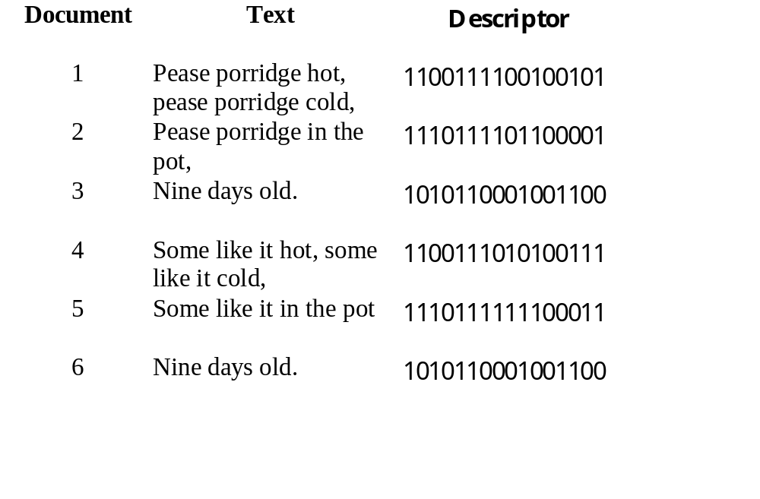
SIGNATURE FILES
What is the descriptor for doc 1?
0000010100000001
0100010000100000
+ 0000101000000000
1000000000100100
1100111100100101
Term | Hash String
cold | 1000000000100100
days | 0010010000001000
hot | 0000101000000000
in | 0000100100100000
it | 0000100010000010
like | 0100001000000001
nine | 0010100000000100
old | 1000100001000000
pease | 0000010100000001
porridge | 0100010000100000
pot | 0000001001100000
some | 0100010000000001
the | 1010100000000000

Slide 44
INDEXES: SIGNATURE FILES
At query time:
  Lookup signature for query term
  If all corresponding 1-bits on in document signature, document probably contains that term
  do false drop checking
Vary s to control P(false drop) vs space
Optimal s changes as collection grows why? – larger vocab. =>more signature overlap
  Wider signatures => lower p(false drop), but storage increases
  Shorter signatures => lower storage, but require more disk access to test for false drops

Slide 45
INDEXES: SIGNATURE FILES
Many variations, widely studied, not widely used.
  Require more space than inverted files
  Inefficient w/ variable size documents since each doc still allocated the same number of signature bits
    Longer docs have more terms: more likely to yield false hits
Signature files most appropriate for
  Conventional databases w/ short docs of similar lengths
  Long conjunctive queries
compressed inverted indices are almost always superior wrt storage space and access time

Slide 46
INVERTED FILE
In general, stores a hierarchical set of address
  at an extreme:
    word number within
    sentence number within
    paragraph number within
    chapter number within
    volume number
Uncompressed take up considerable space
  50 – 100% of the space the text takes up itself
  stopword removal significantly reduces the size
  compressing the index is even better

Slide 47
THE DICTIONARY
Binary search tree
  Worst case O(dictionary-size) time
    must look at every node
  Average O(lg(dictionary-size))
    must look at only half of the nodes
  Needs space for left and right pointers
    nodes with smaller values go in left branch
    nodes with larger values go in right branch
  A sorted list is generated by traversal

Slide 48
THE DICTIONARY
A sorted array
  Binary search to find term in array O(log(size-dictionary))
    must search half the array to find the item
  Insertion is slow O(size-dictionary)

Slide 49
THE DICTIONARY
A hash table
  Search is fast O(1)
  Does not generate a sorted dictionary

Slide 50
THE INVERTED FILE
Dictionary
  Stored in memory or
  Secondary storage
Each record contains a pointer to inverted list, the term, possibly df, and a term number/ID
A postings file - a sequential file with inverted lists sorted by term ID

Slide 51
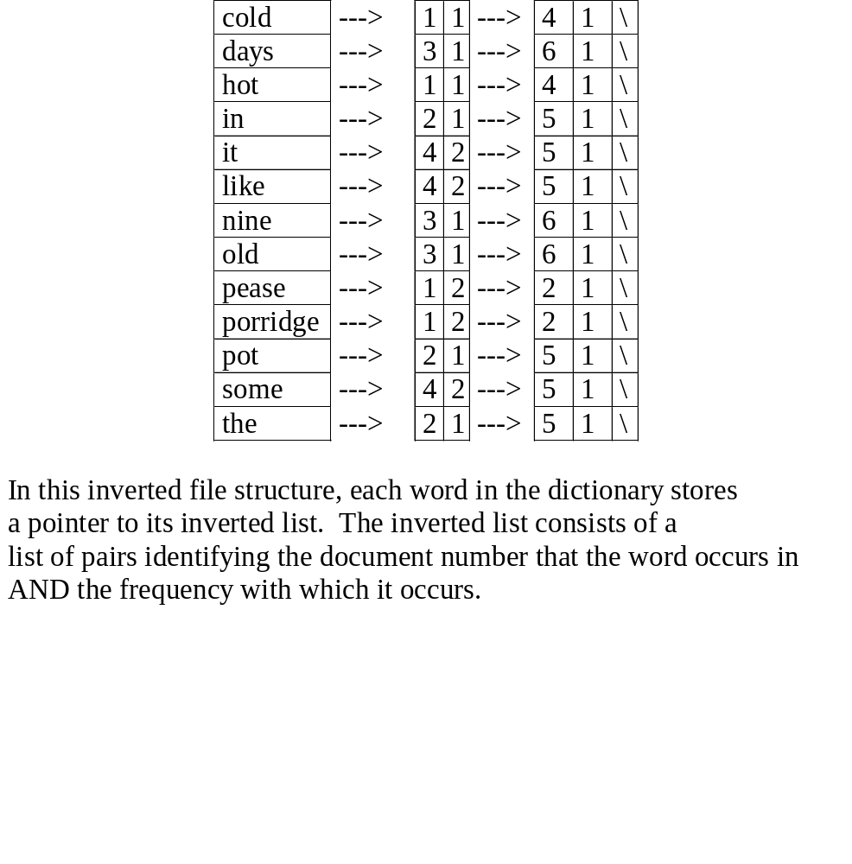

Slide 52
BUILDING AN INVERTED FILE
Initialization
  Create an empty dictionary structure S
Collect term appearances
  For each document D_{i} in the collection
    Scan D_{i} (parse into index terms)
  Fore each index term t
    Let f_{d,t} be the freq of term t in Doc d
    search S for t
    if t is not in S, insert it
    Append a node storing (d, f_{d,t} ) to t’s inverted list
Create inverted file
  Start a new inverted file entry for each new t
  For each (d, f_{d,t} ) in the list for t, append (d, f_{d,t} ) to its inverted file entry
  Compress inverted file entry if need be
  Append this inverted file entry to the inverted file

Slide 53
WHAT ARE THE CHALLENGES?
Index is much larger than memory (RAM)
  Can create index in batches and merge
    Fill memory buffer, sort, compress, then write to disk
    Compressed buffers can be read, uncompressed on the fly, and merge sorted
    Compressed indices improve query speed since time to uncompress is offset by reduced I/O costs
Collection is larger than disk space (e.g. web)
Incremental updates
  Can be expensive
  Build index for new docs, merge new with old index
  In some environments (web), docs are only removed from the index when they can’t be found

Slide 54
WHAT ARE THE CHALLENGES?
Time limitations (e.g.incremental updates for 1 day should take < 1 day)
Reliability requirements (e.g. 24 x 7?)
Query throughput or latency requirements
Position/proximity queries

Slide 55
INVERTED FILES/SIGNATURE FILES/BITMAPS
Signature/inverted files consume order of magnitude less 2ry storage than do bitmaps
Sig files
  false drops cause unnecessary accesses to main text
    Can be reduced by increasing signature size, at cost of increased storage
  Queries can be difficult to process
  Long or variable length docs cause problems
  2-3x larger than compressed inverted files
  No need to store vocabulary separately, when
    Dictionary too large for main memory
    vocabulary is very large and queries contain 10s or 100s of words
      inverted file will require 1 more disk access per query term, so sig file may be more efficient

Slide 56
INVERTED FILES/SIGNATURE FILES/BITMAPS
Inverted Files
  If access inverted lists in order of length, then require no more disk accesses than signature files
  As efficient for typical conjunctive queries as signature files
  Can be compressed to address storage problems
  Most useful for indexing large collection of variable length documents

Slide 57
EVALUATION
Relevance
Evaluation of IR Systems
  Precision vs. Recall
  Cutoff Points
  Test Collections/TREC
  Blair & Maron Study

Slide 58
WHAT TO EVALUATE?
How much learned about the collection?
How much learned about a topic?
How much of the information need is satisfied?
How inviting the system is?

Slide 59
WHAT TO EVALUATE?
What can be measured that reflects users’ ability to use system? (Cleverdon 66)
  Coverage of Information
  Form of Presentation
  Effort required/Ease of Use
  Time and Space Efficiency
  Recall
    proportion of relevant material actually retrieved
  Precision
    proportion of retrieved material actually relevant
effectiveness

Slide 60
RELEVANCE
In what ways can a document be relevant to a query?
  Answer precise question precisely.
  Partially answer question.
  Suggest a source for more information.
  Give background information.
  Remind the user of other knowledge.
  Others ...

Slide 61
STANDARD IR EVALUATION
Retrieved
Documents
Precision
Recall
# relevant retrieved
# retrieved
# relevant retrieved
# relevant in collection
Collection

Slide 62
PRECISION/RECALL CURVES
There is a tradeoff between Precision and Recall
So measure Precision at different levels of Recall
precision
x
x
x
x
recall

Slide 63
PRECISION/RECALL CURVES
Difficult to determine which of these two hypothetical results is better:
precision
x
x
x
x
recall

Slide 64
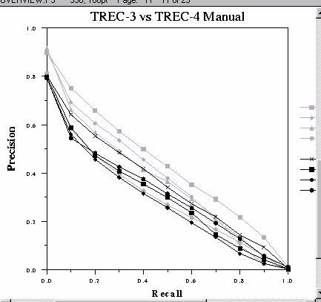
PRECISION/RECALL CURVES

Slide 65
DOCUMENT CUTOFF LEVELS
Another way to evaluate:
  Fix the number of documents retrieved at several levels:
    top 5, top 10, top 20, top 50, top 100, top 500
  Measure precision at each of these levels
  Take (weighted) average over results
This is a way to focus on high precision

Slide 66
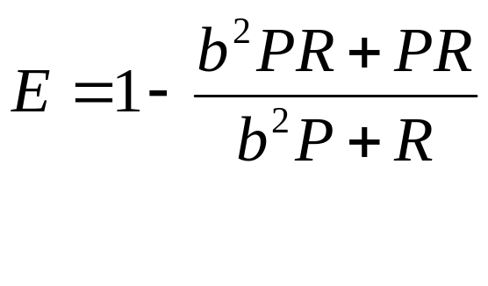
THE E-MEASURE
Combine Precision and Recall into one number (van Rijsbergen 79)
P = precision
R = recall
b = measure of relative importance of P or R
For example,
b = 0.5 means user is twice as interested in
precision as recall

Slide 67
TREC
Text REtrieval Conference/Competition
  Run by NIST (National Institute of Standards & Technology)
  1997 was the 6th year
Collection: 3 Gigabytes, >1 Million Docs
  Newswire & full text news (AP, WSJ, Ziff)
  Government documents (federal register)
Queries + Relevance Judgments
  Queries devised and judged by “Information Specialists”
  Relevance judgments done only for those documents retrieved -- not entire collection!
Competition
  Various research and commercial groups compete
  Results judged on precision and recall, going up to a recall level of 1000 documents

Slide 68
SAMPLE TREC QUERIES (TOPICS)
<num> Number: 168
<title> Topic: Financing AMTRAK
<desc> Description:
A document will address the role of the Federal Government in financing the operation of the National Railroad Transportation Corporation (AMTRAK)
<narr> Narrative: A relevant document must provide information on the government’s responsibility to make AMTRAK an economically viable entity. It could also discuss the privatization of AMTRAK as an alternative to continuing government subsidies. Documents comparing government subsidies given to air and bus transportation with those provided to aMTRAK would also be relevant.

Slide 69
TREC
Benefits:
  made research systems scale to large collections (pre-WWW)
  allows for somewhat controlled comparisons
Drawbacks:
  emphasis on high recall, which may be unrealistic for what most users want
  very long queries, also unrealistic
  comparisons still difficult to make, because systems are quite different on many dimensions
  focus on batch ranking rather than interaction
  no focus on the WWW

Slide 70
TREC RESULTS
Differ each year
For the main track:
  Best systems not statistically significantly different
  Small differences sometimes have big effects
    how good was the hyphenation model
    how was document length taken into account
  Systems were optimized for longer queries and all performed worse for shorter, more realistic queries
Excitement is in the new tracks
  Interactive
  Multilingual
  NLP

Slide 71
BLAIR AND MARON 1985
Highly influential paper
A classic study of retrieval effectiveness
  earlier studies were on unrealistically small collections
Studied an archive of documents for a legal suit
  ~350,000 pages of text
  40 queries
  focus on high recall
Used IBM’s STAIRS full-text system
Main Result: System retrieved less than 20% of the relevant documents for a particular information needs when lawyers thought they had 75%
But many queries had very high precision

Slide 72
BLAIR AND MARON, CONT.
Why recall was low
  users can’t foresee exact words and phrases that will indicate relevant documents
    “accident” referred to by those responsible as:
    “event,” “incident,” “situation,” “problem,” …
    differing technical terminology
    slang, misspellings
  Perhaps the value of higher recall decreases as the number of relevant documents grows, so more detailed queries were not attempted once the users were satisfied

Slide 73
BLAIR AND MARON, CONT.
Why recall was low
  users can’t foresee exact words and phrases that will indicate relevant documents
    “accident” referred to by those responsible as:
    “event,” “incident,” “situation,” “problem,” …
    differing technical terminology
    slang, misspellings
  Perhaps the value of higher recall decreases as the number of relevant documents grows, so more detailed queries were not attempted once the users were satisfied

